Slide 1
Introduction to Subject

Slide 2
Course Objectives
1. To understand NLP and to learn how to apply basic algorithms in this field.
2. To get acquainted with the basic concepts and algorithmic description of the main language levels: morphology, syntax, semantics, and pragmatics.
3. To design and implement applications based on NLP
4. To implement various language Models.
5. To design systems that uses NLP techniques

Slide 3
Course Outcomes
1. Have a broad understanding of the field of NLP.
2. Have a sense of capabilities and limitations of current NLP technologies
3. Be able to model linguistic phenomena with formal grammars
4. Be able to design, implement and test algorithms for NLP problems
5. Understand the mathematical and linguistic foundations underlying approaches to the various areas in NLP
6. Be able to apply NLP techniques to design real world NLP applications such as machine translation, text categorization, text summarization, information extraction...etc.

Slide 4
Prerequisites
Data Structures and Algorithms
Theory of Computer Science
Probability Theory

Slide 5
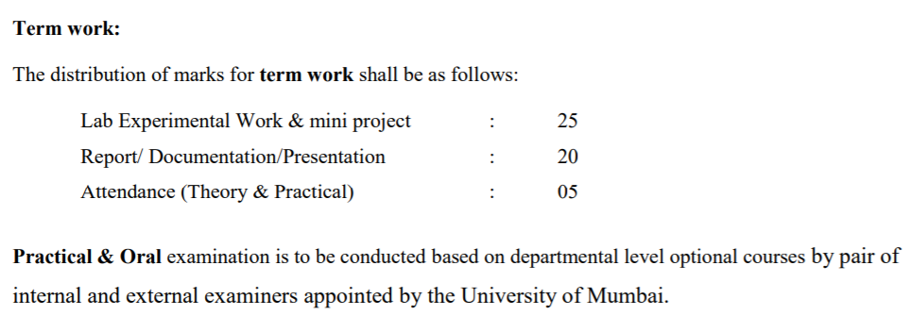
Exam:

Slide 6
Natural Language Processing

Slide 7
Module 1:Introduction
History of NLP
Generic NLP system
Levels of NLP / Stages in NLP
Knowledge in Language Processing
Ambiguity in Natural language
Challenges of NLP
Applications of NLP

Slide 8
What is NLP?
Natural Language Processing (NLP) is a branch of AI that deals with the interaction between computers and humans using the natural language.
Objective of NLP : To read, understand and make sense of the languages we speak.
Goal : To enable computers perform useful tasks involving human language like
enabling human-machine communication,
improving human-human communication, or
simply doing useful processing of text or speech.

Slide 9
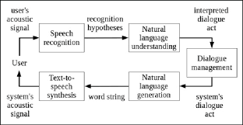
Tasks of NLP
Conversational Agent : It includes two major components as
language input (automatic speech recognition and natural language understanding) and
language output (dialogue and response planning and speech synthesis).

Slide 10
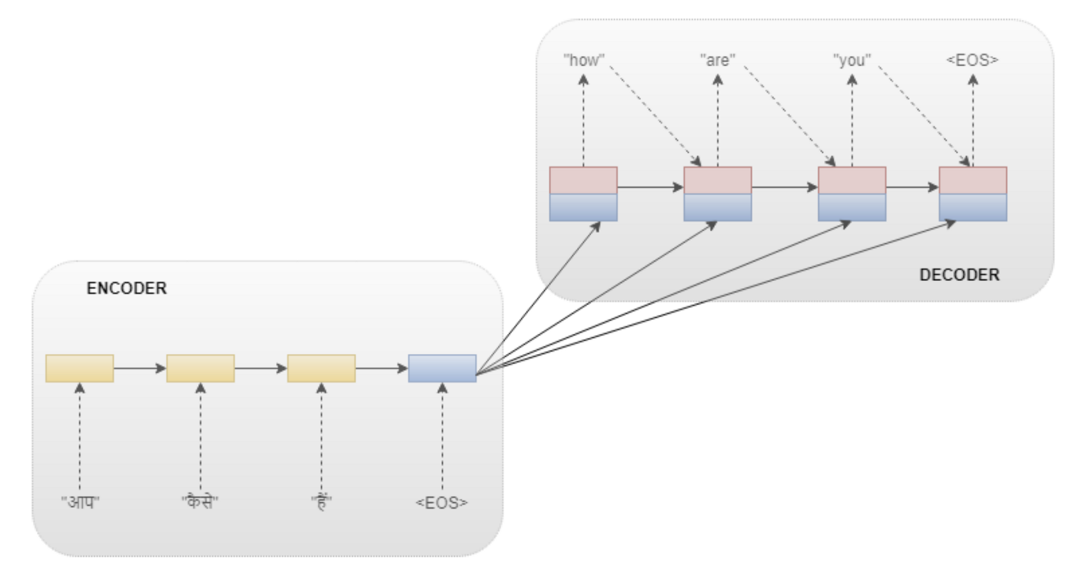
Tasks of NLP
Machine Translation : It automatically translate a document from one language to another.

Slide 11
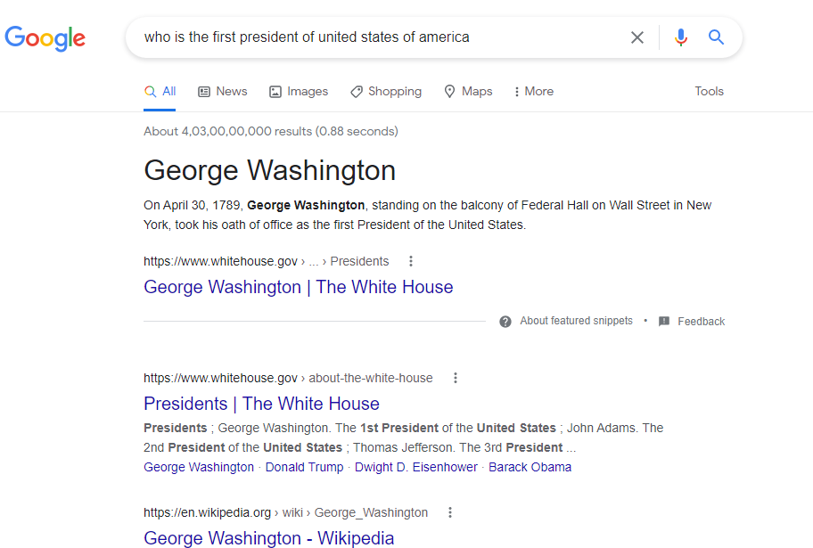
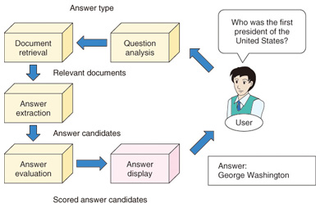
Tasks of NLP
Web-based Question Answering : It involves
extracting information that is embedded in other text on a Web page
doing inference (drawing conclusions based on known facts),
synthesizing and summarizing information from multiple sources or Web pages.
Notes:
First, the question analysis module analyzes a question and determines its answer type. An answer type represents the type of information requested by a question: a person’s name, place name, and a numerical expression are some of the possible answer types. For Who was the first president of the United States?, the answer type is person (person’s name). When the granularity of answer types becomes fine-grained, it is possible to grasp the requested information with pinpoint precision, although there is a trade-off between the number of answer types and the accuracy of automatic answer-type classification. The information retrieval module uses a search engine to retrieve relevant documents on the basis of keywords in the question. Since the question answering system searches for answers only in those retrieved documents, the accuracy of document retrieval is very important. The answer extraction module extracts from the retrieved documents all answer candidates matching the answer type. When the answer type is person, all person names in the retrieved documents are extracted. Named entity recognition technology [2] is used for this extraction. Finally, the answer evaluation module evaluates the appropriateness of candidate answers by using such information as how they appear in the documents, and assigns scores to the candidate answers. Finally, highly scoring candidate answers are presented to the user.

Slide 12
What is NLP?
Natural language processing (NLP) is a subfield of linguistics, computer science, information engineering and artificial intelligence concerned with the interactions between computers and human (natural) languages, in particular how to program computers to process and analyze large amounts of natural language data.

Slide 13
Why NLP?
Natural language refers to the way we communicate with each other using speech and text.
In today’s world, we are surrounded by text.
Think about how much text you see each day:???

Slide 14


SMS : Our Good Morning!!!

Slide 15
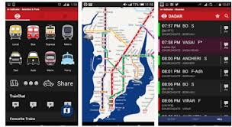
Signs

Slide 16

Menus

Slide 17
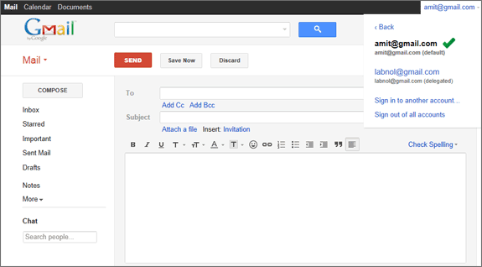
Email

Slide 18
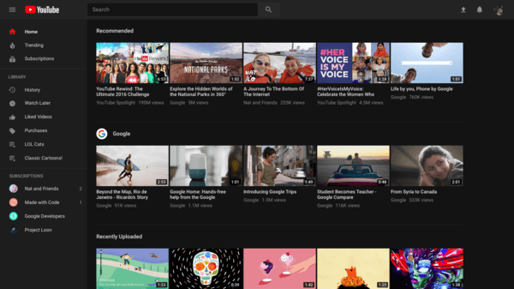
Web Pages
and so much more…
The list is endless.

Slide 19
Need of NLP
Computers understands structured form of data (like spreadsheets)
Human languages are unstructured
It is difficult for computer to understand human and hence we need
NATURAL LANGUAGE PROCESSING

Slide 20
History of NLP

Slide 21
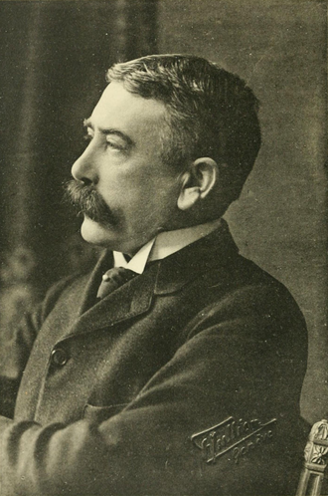
1900-1950
From 1906 to 1911, Professor Ferdinand de Saussure offered 3 courses at University of Geneva, describing languages as “systems.”
Language is a well-defined homogeneous object (set of words) in the heterogeneous mass of speech facts (?AI).
Speech is many-sided and heterogeneous: it belongs both to the individual and to society.
Language is "a system of signs that express ideas".

Slide 22
The sign
The focus of Saussure's investigation is linguistic unit or sign.
The sign (signe) is described as a "double entity", made up of
the signifier, or sound pattern (referred to by Saussure as a 'signal'), and
the signified, or concept (referred to by Saussure as 'signification’).
Both components of the linguistic sign are inseparable.

Slide 23
Close your eyes and imagine that you are sitting under a TREE

Slide 24
Try to find out the name of the TREE

Slide 25

Arbitrariness
There is no reason why a particular signifier should be attached to a particular signified.
No two people have precisely the same concept of "tree," since no two people have precisely the same experiences or psychology.

Slide 26
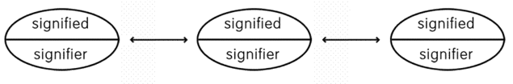
Value
The value of a sign is determined by all the other signs in the language (speech).
Language could not be a mere nomenclature
Sheep, for example, has the same meaning as mutton, but not the same value, for mutton can be used to mean the meal lamb whereas sheep cannot.
It would be different if I tell u imagine the tallest tree u have seen

Slide 27
Structuralist Approach
Saussure laid the foundation
This approach implies that to understand concept of linguistics one must understand the subsets and how these fit into the overarching structure.
These subsets all fit and work together collaboratively.
It says that components of language are interrelated to one another and get their meaning from that relationship.
E.g. singing (ing implies being in the state)

Slide 28
Principles of Structuralism
Teaching English from a structuralist approach include a focus on
sentence structure
patterns of sentences and
appropriate grammar and composition.
Teaching English requires four main skills:
Understanding the grammatical structures
Speaking properly (With rules of proper grammar and mechanics and using proper sentence structure)
Reading properly (With the rules of comprehension)
Writing properly (With rules of proper grammar and mechanics and using proper sentence structure)
Focuses on order of words than meaning:
The girl tasted the cake.
The cake tasted the girl.

Slide 29
Strengths of Structuralism
In English,
It make language easy to learn.
It make access to the language more concrete.
It felicitates proper use of language in verbal and written expression.
Learner will be able to speak and write English in a proper manner.

Slide 30
Weaknesses of Structuralism
The focus is often so structured relies on rote memory, there is less focus on the reading and creative writing of the students.
Structured: Let us eat some apples.
Unstructured: Hey here are some apples.

Slide 31
LEC 01 ENDS

Slide 32
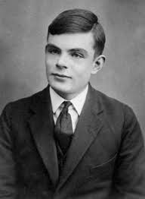
1950-1966
In 1950, Alan Turing wrote a paper on “thinking” machine.
He stated that if a machine could be part of a conversation so that it will imitate a human so completely there were no noticeable differences between two.

Slide 33
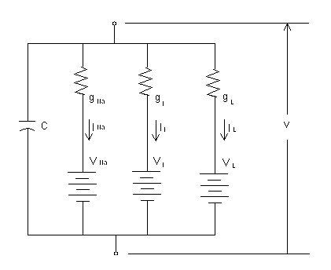
1950-1966
In 1952, Hodgkin-Huxley model showed how brain uses neurons in forming an electrical network.
These events helped inspire the idea of AI, NLP and the evolution of computers.

Slide 34
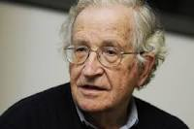
NLP Begins and Stops
Noam Chomsky published his book, Syntactic Structures, in 1957.
For a computer to understand a language, the sentence structure would have to be changed.
With this as his goal, he created a style of grammar called Phase-Structure Grammar, to translate natural language to a format usable by computers.

Slide 35

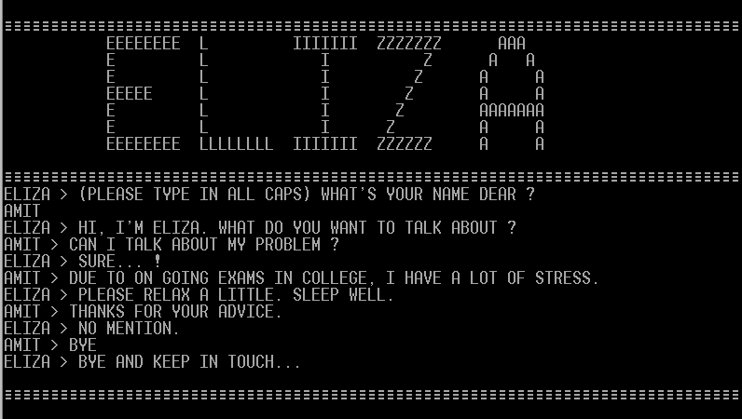
NLP Begins and Stops
In 1958, LISP (Locator/Identifier Separation Protocol) was released by John McCarthy.
In 1964, ELIZA was designed to imitate a psychiatrist using reflection techniques, was developed.
In 1964, the U.S. National Research Council (NRC) created the Automatic Language Processing Advisory Committee (ALPAC) to track progress of NLP Research.

Slide 36
NLP Begins and Stops
In 1966, the NRC and ALPAC initiated the first AI and NLP stoppage
After 12 years of research, and $20 million dollars, machine translations were more expensive than human translations

Slide 37
1980-2000 : Return of the NLP
Until the 1980s, NLP systems used complex, “handwritten” rules.
NLP researchers started using ML algorithms.
Started incorporating statistical models capable of making probabilistic decisions
In 1990s, N-Grams have become useful, recognizing and tracking clumps of linguistic data, numerically.
In 1997, LSTM recurrent neural net (RNN) models were introduced, and found their niche in 2007 for voice and text processing.
Currently, neural net models are considered the cutting edge of research and development in NLP

Slide 38
After the Year 2000
In 2001, Yoshio Bengio proposed the first neural “language” model, using a feed-forward neural network.
In 2011, Apple’s Siri became known as one of the world’s first successful NLP/AI assistants to be used by general consumers.
Siri matches concepts to predefined commands, initiating specific actions.
For example, if Siri asks, “Do you want to hear your balance?” it would understand a “Yes” or “No” response, and act accordingly.
Our modern AIs, still are not able to pass Alan Turing’s test, and currently do not sound like real human beings. (Not yet, anyway.)
To conclude, Computers can’t truly understand human language. If it encounters a new word it makes the nearest guess which can be wrong a few times.

Slide 39
Coding in Python
NLTK tool kit
To install NLTK run the following commands in your terminal.
sudo pip install nltk
Then, enter the python shell in your terminal by simply typing python
import nltk
nltk.download(‘all’)

Slide 40
Stages in NLP
Phonetics and phonology
Morphology
Lexical Analysis
Syntactic Analysis
Semantic Analysis
Pragmatics
Discourse

Slide 41
Phonetics and phonology
It involves two major tasks:
Capability of analyzing an incoming audio signal and recover exact sequence of words
Ability to take a sequence of words and generate an audio signal
It is the study of linguistic sounds

Slide 42
Challenges in Phonetics and Phonology
Homophones :
A homophone is a word that is pronounced the same (to varying extent) as another word but differs in meaning.
E.g. rose (flower) and rose (past tense of "rise")
A homophone may also differ in spelling.
E.g.
carat and carrot
to, two, and too

Slide 43
Challenges in Phonetics and Phonology
Near Homophones :
A near homophone is a word which is pronounced almost the same as another word but has a different spelling and meaning.
Example:
Precede Proceed
Accept Except

Slide 44
Challenges in Phonetics and Phonology
Word Boundary : Ending point of a word & beginning of the next word is called word boundary.
E.g.
aajaayenge (aa jaayenge (will come)
aaj aayenge (will come today)
I got a plate
I got up late

Slide 45
Challenges in Phonetics and Phonology
Phrase Boundary : Ending of a phrase & beginning of the next phrase is called phrase boundary.
E.g.
The old (men and women)] stayed at home."
The [(old men) and women] stayed at home."
"(A plus E) times O"
"A plus (E times O)”

Slide 46
Challenges in Phonetics and Phonology
Speech Disfluency:
It is any of various breaks, irregularities, or non-lexical vocables which occur within the flow of otherwise fluent speech.
E.g. “ok”, "huh", "uh", "erm", "um", "well", "so", "like", and "hmm"

Slide 47
Morphology
It is the study of meaningful components of words
It deals with the word formation rules from the root words.
In linguistics, morphology is the study of words, how they are formed, and their relationship to other words in the same language.
It analyzes the structure of words and parts of words, such as stems, root words, prefixes, and suffixes.

Slide 48
Morphology
E.g friendships
It contains the stem friend, to which the derivational suffix -ship is attached to form a new stem friendship, to which the inflectional suffix -s is attached.
Root word is friend and stem is friendship
Includes the ways new words are coined in the languages of the world

Slide 49
Definition of Word

Slide 50
Stop and think a minute:
Suppose that splinch is a verb that means ‘step on broken glass’; what is its past tense?

Slide 51
Stop and think a minute:
2. Speakers of English use the suffixes -ize (crystallize) and -ify (codify) to form verbs from nouns. If you had to form a verb that means ‘do something the way ex-Prime Minister Tony Blair does it’, which suffix would you use? How about a verb meaning ‘do something the way exPresident Bill Clinton does it’?

Slide 52
Stop and think a minute:
3. It’s possible to rewash or reheat something. Is it possible to relove, reexplode, or rewiggle something?

Slide 53
Solutions
Splinched
Blairify and Clintonize,
They are weird to use.

Slide 54
Morphemes
Linguists define a morpheme as the smallest unit of language that has its own meaning.
Simple words like giraffe, wiggle, or yellow
Prefixes like re- and pre- and suffixes like -ize and -er.

Slide 55
Definition of Word
Word is defined as one or more morphemes that can stand alone in a language.
Simple / Simplex Words : Words that consist of only one morpheme
Examples of Simplex words :
giraffe , fraud , murmur
Complex Words : Words that are made up of more than one morpheme
Examples of Complex words :
opposition , intellectual, crystallize

Slide 56
Morphology
Languages may be rich or poor in morphology
Rich in morphology : Dravidian, Hungarian and Turkish.
Poor in morphology : Chinese and English.
Languages rich in morphology have the advantage of easier processing at higher stages.
A task of interest in Computer Science is to study over Finite State Machines for Word Morphology.

Slide 57
Challenges in Word Morphology
Part of Speech Ambiguity: Words can take both forms : Noun and Verb.
Dog as a Noun (animal)
Dog as a Verb (to pursue)
Sense Ambiguity: The word sense ambiguity problem comes in, after parts of speech is disambiguation is over.
Consider dog now treated as noun.
Dog as animal
Dog as a very detestable person

Slide 58
Challenges in Word Morphology
Word Relationships in Context : If there are no clues in the sentence about the word's meaning.
The chair emphasised the need for adult education.
Watch what you want, when you want (meaning : Be careful /Look carefully (Ad))

Slide 59
Technological Developments bring in new terms:
Examples :
Xeroxed : a new verb
Communifaking : Pretending to talk over phone
Discomgooglation : Discomfort when there is no internet access
Helicopter Parenting : Overparenting.
Typo : TEXTO and SPEAKO

Slide 60
Lec 02 Ends

Slide 61
Syntax
It is the study of structural relationships between words.
It refers to arrangement of words in a sentence to make grammatical sense.
Syntactic analysis or Parsing :
It is the process of analyzing the strings of symbols in natural language conforming to the rules of formal grammar.
It is the task of recognizing a sentence and assigning a syntactic structure to it.

Slide 62
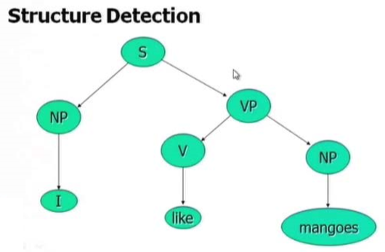

Slide 63
Syntax
Syntax defines the rules to organize words in a sentence on the basis of the following elements:
Constituents :
The syntax rules generally involve atomic tokens made up of a group of words.
They are known as chunks (units at the syntax level).
E.g, the noun phrase consists of groups made up of nouns, determiners, adjectives, conjunctions
Find the elements of the phrase given below:
the big house
a red and large carpet

Slide 64
Syntax
Solution:
the big house (determiner, adjective, noun)
a red and large carpet (determiner, adjective, conjunction, adjective, noun)

Slide 65
Syntax
Grammatical relations : It represent the formalization of the sentence structure as a link between SUBJECTS and OBJECTS es.
[he]/SUBJECT took [the big hammer]/OBJECT
Sub Categorizations and Dependency Relations : they are rules that express constraints between words and phrasal groups
e.g. want can be followed either by a verb infinite form or a noun phrase as object (I want to walk, I want a cake) whereas find can be followed only by a noun phrase (I found a treasure)

Slide 66
Constituents and Chunking
One or more words can be grouped together to form a constituent or chunk that has a specific role in a sentence.
A kind of constituent, e.g. a noun phrase NP, can only appear in given contexts,
e.g. NP before a verb
[the flight from Paris] arrives late
[Philip’s new car] is parked outside

Slide 67
Constituents and Chunking
Other kinds of constituents may have more than one admissible structure (preposed, postposed)
[On June 17th] I’ll give the last lecture
I’ll give the last lecture [on June 17th]
In any case the words composing a chunk are always organized as a unique group
Chunks can be modeled by Context Free Grammars

Slide 68
Challenges in Syntactic Processing
Scope : Scope ambiguity means what is the reason of influence or scope of a particular word.
No smoking areas will allow Hookas inside
Preposition Phrase Attachment: This ambiguity arises from multiple possibilities of attachment of preposition phrase in the sentence.
I saw the boy with a telescope
(who has the telescope?)
I saw the mountain with a telescope
(world knowledge: mountain cannot be an instrument of seeing, mountain can be fitted with telescope)
I saw the boy with the pony-tail
(world knowledge: pony-tail cannot be an instrument of seeing)
Very ubiquitous: newspaper headline “20 years later, BMC pays father 20 lakhs for causing son’s death”

Slide 69
Exercise :
Find out the different meanings that can be there in the given sentence:
The camera man shot the man with the gun when he was near Tendulkar

Slide 70
Solution:
Shot :
2 Meanings : gun shot and camera shot
With the gun :
2 attachment :shot / man
When he was near Tendulkar :
he ? cameraman / man

Slide 71
Semantic Analysis
The purpose of semantic analysis is to draw exact meaning from the text.
Semantic Analysis can be divided into the following two parts.
Lexical Semantics : study of the meaning of individual words.
The second part focuses on larger chunks.

Slide 72
Important Elements of Semantic Analysis
Hyponymy:
It may be defined as the relationship between a generic term and instances of that generic term.
The generic term is called hypernym and its instances are hyponyms.
For example,
Hypernym : color
Hyponyms : blue, yellow, red

Slide 73
Important Elements of Semantic Analysis
Homonymy:
It may be defined as the words having the same spelling or same form but having different and unrelated meaning.
For example,
Homonymy : Bat
Meaning : cricket-bat, bird-bat

Slide 74
Important Elements of Semantic Analysis
Polysemy :
It is a word or phrase with different but related sense.
Same spelling with different and related meaning.
For example, man
The human species (i.e., man vs. other organisms)
Males of the human species (i.e., man vs. woman)
Adult males of the human species (i.e., man vs. boy)

Slide 75
Difference b/w Polysemy and Homonymy
Polysemy : Words are related
Homonymy : Words are not related

Slide 76
Synonymy
It is the relation between two lexical items having different forms but expressing the same or a close meaning.
Examples are ‘author/writer’, ‘fate/destiny’.

Slide 77
Antonymy
It is the relation between two lexical items having symmetry between their semantic components relative to an axis.
Scope of antonymy is as follows −
Application of property or not : ‘life/death’, ‘thankful /thankless’
Application of scalable property : ‘rich/poor’, ‘hot/cold’
Application of a usage : Example is ‘father/son’, ‘moon/sun’.

Slide 78
Meaning Representation
Semantic analysis creates a representation of the meaning of a sentence.

Slide 79
Building Blocks of Semantic System
In meaning representation, the building blocks that play an important role are :
Entities : It represents the individual such as a particular person, location etc.
E.g. Haryana, India, Ram, etc.

Slide 80
Building Blocks of Semantic System
Concepts : It represents the general category of the individuals
E.g. person, city, etc.
Relations : It represents the relationship between entities and concept.
E.g. Ram is a person.
Predicates : It represents the verb structures.
E.g. semantic roles and case grammar

Slide 81
Semantic Role
A semantic role is the underlying relationship that a participant has with the main verb in a clause.
E.g. Ram and Sam are good friends : GoodFriends(Ram,Sam)

Slide 82
Example :
Accompaniment As A Semantic Role
Agent As A Semantic Role
Beneficiary As A Semantic Role
Causer As A Semantic Role
Counteragent As A Semantic Role
Dative As A Semantic Role
Experiencer As A Semantic Role
Factitive As A Semantic Role
Force As A Semantic Role
Goal As A Semantic Role
Measure As A Semantic Role
Result

Slide 83
Semantic Role Labeling
It is the process that assigns labels to words or phrases in a sentence that indicate their semantic role in the sentence.
E.g Named Entity Recognition (NER)
The task of NER is to find each mention of a named entity in the text and label its type

Slide 84
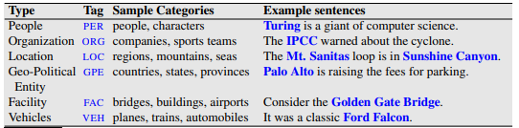
Named Entity Recognition

Slide 85
Meaning Representation
Meaning representation involves putting together entities, concepts, relations and predicates to describe a situation.
It also enables the reasoning about the semantic world.

Slide 86
Approaches to Meaning Representations
Semantic analysis uses the following approaches for the representation of meaning :
First order predicate logic (FOPL)
Semantic Nets
Frames
Conceptual dependency (CD)
Rule-based Architecture
Case Grammar
Conceptual Graphs

Slide 87
Knowledge Representation in Semantics

Slide 88
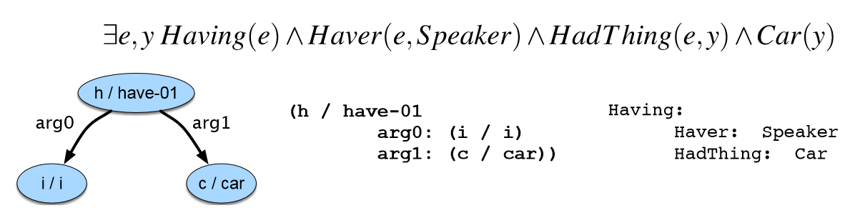
First Order Predicate Logic (FOPL)

Slide 89
How it removes ambiguity?
Example :
I saw a boy with pony tail
Pony tail is not an object that can be an instrument to see so it can be attached only with object “boy”

Slide 90
Challenges in Semantic Processing
Ambiguity in Semantic Role Labeling
Example:
(Eng) Visiting aunts can be a nuisance
Different Meanings which lead to ambiguity are
It is not nice to go and visit aunts
It is not nice to have visiting aunts at home.
(Hin) aapko mujhe mithaai khilaanii padegii (ambiguous in Marathi and Bengali too; not in Dravidian languages)
You have to get me sweets
I have to give you sweets

Slide 91
Pragmatics
Pragmatic analysis deals with outside word knowledge
knowledge that is external to the documents and/or queries.
It studies the ways in which context contributes to meaning.
E.g.
Tourist (in a hurry, checking out of the hotel, motioning to the service boy): Boy, go upstairs and see if my sandals are under the divan. Do not be late. I just have 15 minutes to catch the train.
Boy (running upstairs and coming back panting): yes sir, they are there.

Slide 92
Pragmatics
E.g. Is that a jug of water ?
Implies pass the jar of water.
World Knowledge :
Will India repeat 2011?
Implies?

Slide 93
How it removes ambiguity?
“Old men and women were taken to safe location”
((old men) and women) as opposed to (old (men and women))will be considered since women- both and young and old- were very likely taken to safe locations.

Slide 94
Stages in NLP
Phonetics and phonology
Morphology
Syntactic Analysis
Semantic Analysis
Pragmatics
Discourse

Slide 95
Discourse
It is the processing of sequence of sentences.
Example:
Mother to John:
John go to school. It is open today. Should you bunk? Father will be very angry.
Interpretation:
Bunk (School) is before one sentence.
Ambiguity of father:
father as parent
or
father as headmaster

Slide 96
How it removes ambiguity?
Example:
No smoking areas allow hookas inside, except the one in Hotel Grand.
No smoking areas allow hookas inside, but not cigars.

Slide 97
Complexity of Connected Text
Example :
John was returning from school dejected – today was the math test
Who is John (Identify the Semantic Role)?

Slide 98
Complexity of Connected Text
Example :
John was returning from school dejected – today was the math test
He couldn’t control the class
Who is John?

Slide 99
Complexity of Connected Text
Example :
John was returning from school dejected – today was the math test
He couldn’t control the class
Teacher shouldn’t have made him responsible
Who is John?

Slide 100
Complexity of Connected Text
Example :
John was returning from school dejected – today was the math test
He couldn’t control the class
Teacher shouldn’t have made him responsible
After all he is just a house keeper.
Who is John?

Slide 101
Complexity of Connected Text
Example :
John was returning from school dejected – today was the math test
(John is student)
He couldn’t control the class
(John is teacher)
Teacher shouldn’t have made him
responsible
(John is monitor)
After all he is just a house keeper.
(John is a housekeeper)

Slide 102
Module 1:Introduction
History of NLP
Generic NLP system
Levels of NLP / Stages in NLP
Knowledge in Language Processing
Ambiguity in Natural language
Challenges of NLP
Applications of NLP

Slide 103
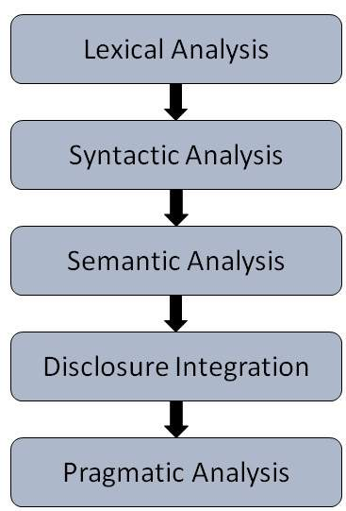
Generic NLP System
A generic NLP system has 5 steps :

Slide 104
Generic NLP System
Lexical Analysis :
It involves identifying and analyzing the structure of words.
Lexicon of a language means the collection of words and phrases in a language.
Lexical analysis is dividing the whole chunk of text into paragraphs, sentences, and words.

Slide 105
Generic NLP System
Syntactic Analysis (Parsing) :
It involves analysis of words in the sentence for grammar and arranging words in a manner that shows the relationship among the words.
The sentence such as “The school goes to boy” is rejected by English syntactic analyzer.

Slide 106
Generic NLP System
Semantic Analysis :
It draws the exact meaning or the dictionary meaning from the text.
The text is checked for meaningfulness.
It is done by mapping syntactic structures and objects in the task domain.
The semantic analyzer disregards sentence such as “hot ice-cream”.

Slide 107
Generic NLP System
Discourse Integration :
The meaning of any sentence depends upon the meaning of the sentence just before it.
In addition, it also brings about the meaning of the immediately succeeding sentence.

Slide 108
Generic NLP System
Pragmatic Analysis :
During this, what was said is re-interpreted on what it actually meant.
It involves deriving those aspects of language which require real world knowledge.

Slide 109
Module 1:Introduction
History of NLP
Generic NLP system
Levels of NLP / Stages in NLP
Knowledge in Language Processing
Ambiguity in Natural language
Challenges of NLP
Applications of NLP

Slide 110
Applications in NLP

Slide 111
Applications in NLP
The different applications are :
Machine Translation
Question Answering System
Information Retrieval
Categorization
Summarization
Sentiment Analysis
Information Extraction

Slide 112
Applications in NLP
The different applications are :
Similarity Detection (Plagiarism Detection)
Text Normalization (Multilanguage to Single Language)
Sarcasm Detection
Cross lingual Information Retrieval
Author Profiling : (Men/Women)(Age Group)
Fake News Detection

